Slide 2
DID YOU KNOW?
There are approximately 15,000 students attending the Banning and Beaumont public schools and 700 in private schools in the Pass Area.
Banning Unified school District has approximately 97% on free or reduced lunch and Beaumont Unified School District has approximately 55%.

Slide 3
Banning Unified School District
58% of the Banning Unified Students only have one parent in the home.

Slide 4
Pass Area Youth are the cherry seeds and we have to create the soil for success.

Slide 5
OUR HISTORY
The Cherry Valley Agriculture Academy (CVAAA) is a 501 (c) (3) non-profit co-founded by Ray “Coach” Curtis, Banning graduate, and David Curtis, Beaumont graduate.
The father and son team have been a part of the Pass Area for a combined total of over 50 years and have joined together Banning Bronco and Beaumont Cougar, skills, knowledge and abilities to give back and help the Pass Area kids in the areas of Athletics, Agriculture and Financial Assistance.

Slide 6
OUR MISSSION
We are dedicated to serve and empower Pass Area youth with life-time knowledge in the importance of agriculture and athletics as a pursuit towards educational, career and life goals through scholarship assistance based upon financial need.

Slide 7
OUR VISION
The CVAAA Academies will be much more than your typical Athletic Camp or agriculture field trip.
Youth will be introduced to agriculture and athletic fundamentals to help them reach their maximum potential in those areas.
Academies will introduce related career and core values to increase opportunities for success in life and careers.

Slide 8
Co-Founder David Curtis, PGA
2017 SCPGA Desert Chapter Assistant Golf Professional of the Year
2016 SCPGA Desert Chapter
Player of the Year
2016 SCPGA Desert Chapter
Assistant Professional Champion
Troon Golf Academy Certified Instructor
Callaway Professional Staff Member

Slide 9
David Curtis, PGA

Slide 10
CO-FOUNDER RAY CURTIS, Coach
Basketball Coaching Accomplishments:
1982 Riverside County Coach of the Year
1975 Riverside County Coach of the Year
CIF Records Most Consecutive League Wins
1982 CIF State Championship Runner-up
1982 CIF Regional Champion
1982 CIF Southern Section Champion
1975 CIF Southern Section Champion
Coaching Experience:
2018-2017 Shooting Coach for CIF Champions Hillcrest High School
1985-1987 Riverside Community College Assistant Coach
John Wooden Basketball Camps
Bill Sharman Basketball Camp
1972-1983 Banning High School

Slide 11
OUR GOALS
PROVIDE a variety of agriculture and athletic activities for young people.
ASSIST students in their mastery of the fundamentals of various sports and career opportunities.
INTRODUCE students to the importance of agriculture and career opportunities.
SUPPORT scholarship assistance to Pass Area Students based on need.
CREATE a synergy between one’s knowledge of agriculture and athletic education, stressing the importance each one plays in the success of a career and life.

Slide 12
LEARNING CENTER
The CVAAA Learning Center will focus on training participants in core values as shown in the Wheel of Success for a lifelong, fulfilling career in agriculture, athletics and life
Adaptability
Commitment
Communication
Interpersonal
Integrity
Passion
Patience
Problem Solving
Skill Development
Sportsmanship
Teamwork
Self-Esteem

Slide 13
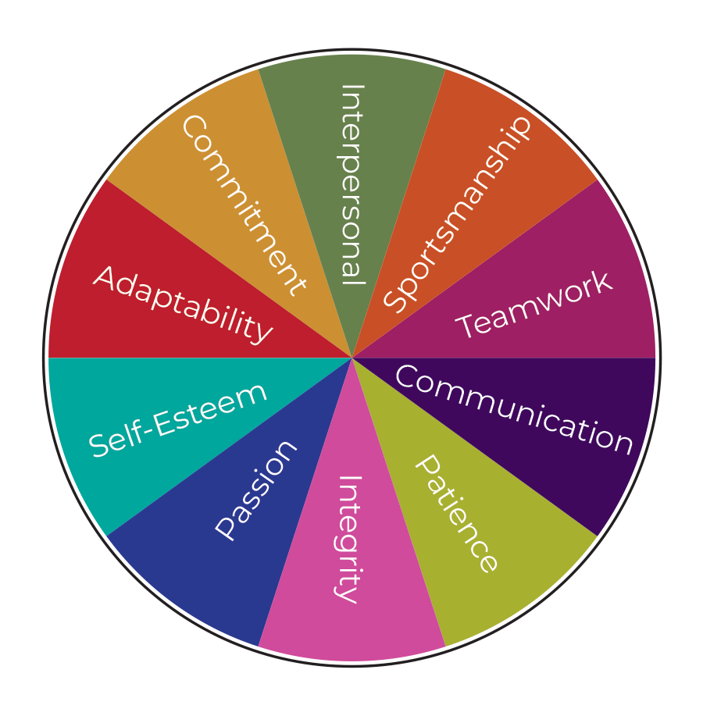
Wheel of Success

Slide 14
AGRICULTURAL CAREERS
Agricultural careers include a diverse field of options for individuals who enjoy working as a team, independently, outdoors and/or with animals.
Animal farming
Dairy farming
Entomologist
Equipment operator
Finance
Florist
Horticulturist
Insurance agent
Landscaper
Ranger
Salesperson
Veterinarian

Slide 15
ATHLETIC CAREERS
Athletic trainer
Chiropractor
Golf instructor
Physical therapist
Photographer
Referee/Umpire
Sports/fitness trainer
Sports broadcaster
Athletic psychologist
Sports reporter
Strength/Conditioning coach
Yoga Instructor

Slide 16
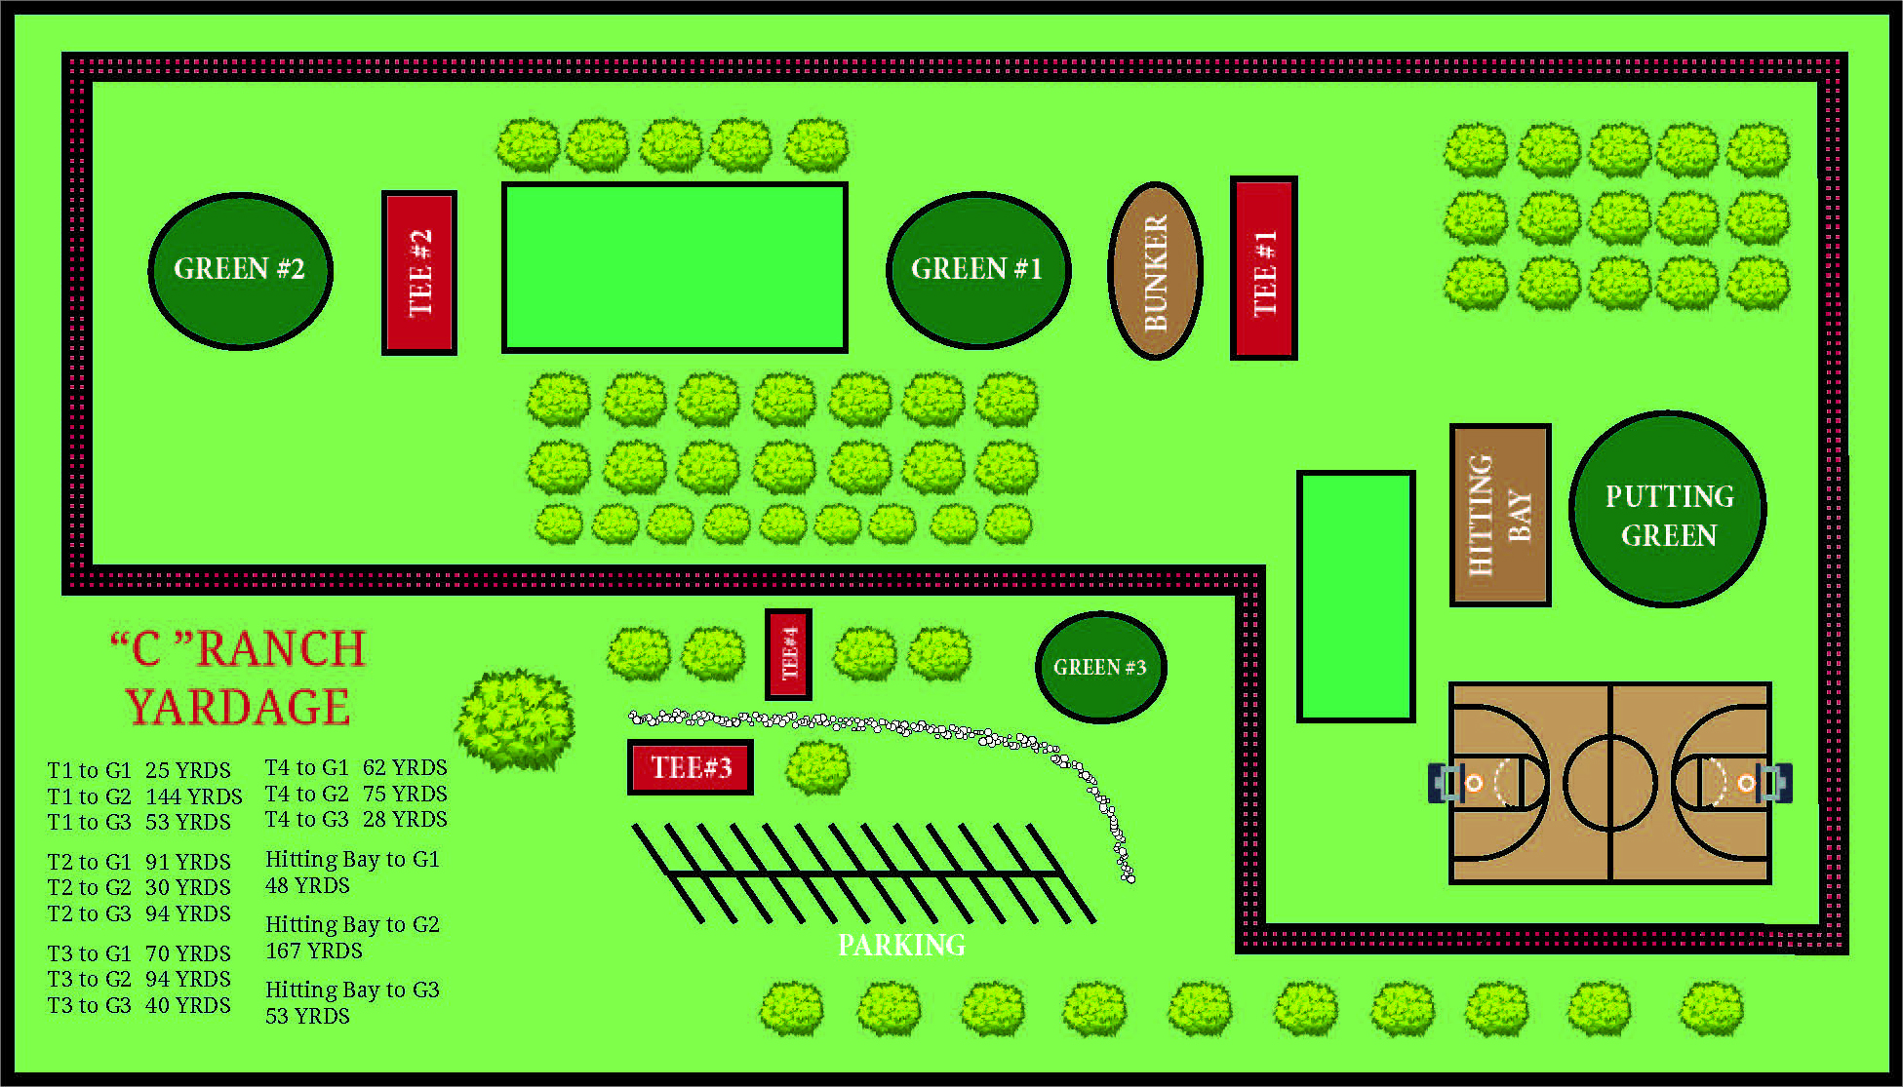
Short Game Course 25 yards to167 yards

Slide 17
Greens Under Construction

Slide 19
Play Pebble Beach

Slide 20
HITTING BAY

Slide 21
BASKETBALL COURT

Slide 22
EVENT STAGING

Slide 23
COACHES WANTED
Golf
Basketball
Baseball
Soccer
Football

Slide 24
FUNDRAISERS
ACADEMIES
AGRICULTURE FESTIVALS
ATHLETIC FESTIVALS
SHORT GAME TOURNAMENTS
3 ON 3 BASKETBALL TOURNAMENTS
DINNER ENGAGEMENTS
WINE TASTING
AND MORE FUN EVENTS

Slide 25
VOLUNTEERS NEEED
If you are interested in helping kids, we are seeking volunteers, Advisory Board and Committee Members with experience or interests in:
Agriculture
Athletics
Event planning
Grant writing
Fundraising
Financial assistance selection

Slide 26
Help Us Help Those in Need
CVAAA is about raising funds to support Pass Area Youth.
We welcome all levels of donations to support our mission.
Your donation can help make a difference!

Slide 27
In Closing

Slide 28
QUESTIONS

